Slide 1
WRES2203 Advanced Network Technology
Chapter 3
Link Aggregation

Slide 2
Contents
Introduction
EtherChannel
PAgP
LACP
Configuring EtherChannel

Slide 3
Introduction
Link aggregation is the ability to create one logical link using multiple physical links between two devices.
This allows load sharing among the physical links, rather than having STP block one or more of the links.
EtherChannel is a form of link aggregation used in switched networks. EtherChannel was originally developed by Cisco as a LAN switch-to-switch technique of grouping several Fast Ethernet or Gigabit Ethernet ports into one logical channel.
When an EtherChannel is configured, the resulting virtual interface is called a port channel.
The physical interfaces are bundled together into a port channel interface.

Slide 4
EtherChannel
Most configuration tasks can be done on the EtherChannel interface instead of on each individual port
Relies on existing switch ports.
Load balancing takes place between links that are part of the same EtherChannel.
Creates an aggregation that is seen as one logical link. Where there is only one EtherChannel link, all physical links in the EtherChannel are active because STP sees only one (logical) link.
Provides redundancy because the overall link is seen as one logical connection.

Slide 5
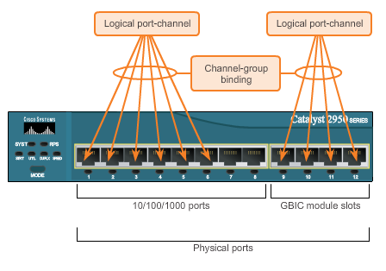
EtherChannel

Slide 6
EtherChannel
Implementation
  Interface types cannot be mixed.
  EtherChannel provides full-duplex bandwidth up to 800 Mb/s (Fast EtherChannel) or 8 Gb/s (Gigabit EtherChannel).
  EtherChannel can consist of up to 16 compatibly-configured Ethernet ports.
  The Cisco IOS switch currently supports six EtherChannels
  EtherChannels can be formed through negotiation using one of two protocols, PAgP or LACP.

Slide 7
PAgP
Port Aggregation Protocol
Cisco-proprietary protocol that aids in the automatic creation of EtherChannel links.
When an EtherChannel link is configured using PAgP, PAgP packets are sent between EtherChannel-capable ports to negotiate the forming of a channel.
When PAgP identifies matched Ethernet links, it groups the links into an EtherChannel.
PAgP packets are sent every 30 seconds. PAgP checks for configuration consistency and manages link additions and failures between two switches.
All ports must have the same speed, duplex setting, and VLAN information.

Slide 8
PAgP
Mode
  On
    Forces the interface to channel without PAgP. Do not exchange PAgP packets.
  PAgP desirable
    Places an interface in an active negotiating state in which the interface initiates negotiations with other interfaces by sending PAgP packets.
  PAgP auto
    Places an interface in a passive negotiating state in which the interface responds to the PAgP packets that it receives, but does not initiate PAgP negotiation.

Slide 9
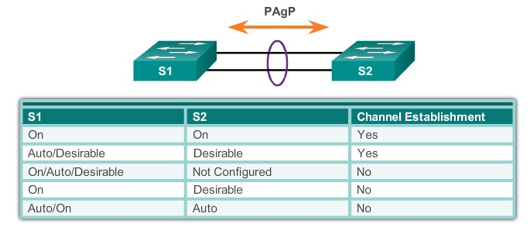
PAgP

Slide 10
LACP
Link Aggregation Control Protocol
Part of an IEEE specification (802.3ad) that allows several physical ports to be bundled to form a single logical channel.
LACP allows a switch to negotiate an automatic bundle by sending LACP packets to the peer
It can be used to facilitate EtherChannels in multivendor environments.

Slide 11
LACP
Mode
  On
    Forces the interface to channel without LACP. Do not exchange LACP packets.
  LACP active
    Places a port in an active negotiating state. In this state, the port initiates negotiations with other ports by sending LACP packets.
  LACP passive
    Paces a port in a passive negotiating state. In this state, the port responds to the LACP packets that it receives, but does not initiate LACP packet negotiation.

Slide 12
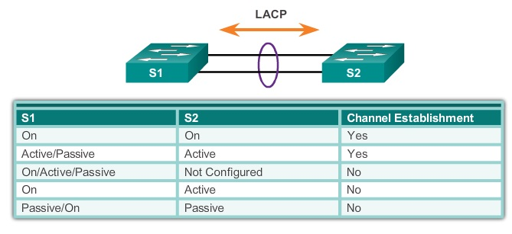
LACP

Slide 13
Configuring EtherChannel
EtherChannel support
  All Ethernet interfaces on all modules must support EtherChannel
Speed and duplex
  Configure all interfaces in an EtherChannel to operate at the same speed and in the same duplex mode.
VLAN match
  All interfaces in the EtherChannel bundle must be assigned to the same VLAN, or be configured as a trunk.

Slide 14
Configuring EtherChannel
Range of VLAN
  Supports the same allowed range of VLANs on all the interfaces in a trunking EtherChannel. If the allowed range of VLANs is not the same, the interfaces do not form an EtherChannel, even when set to auto or desirable mode.

Slide 15
Configuring EtherChannel
Step 1. Specify the interfaces that compose the EtherChannel group
  interface range
Step 2. Create the port channel interface
  channel-group identifier mode active
  The identifier specifies a channel group number. The mode active keywords identify this as an LACP EtherChannel configuration.

Slide 16
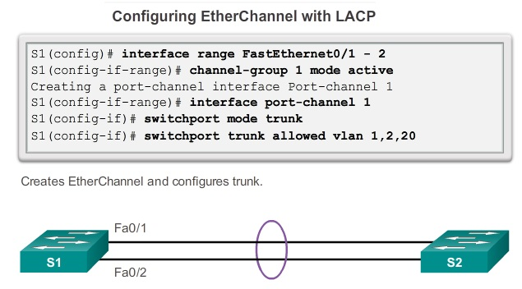
Configuring EtherChannel

Slide 17
Configuring EtherChannel
show interface Port-channel
  Displays the general status of the EtherChannel interface.
show etherchannel summary
  Displays one line of information per port channel.
show etherchannel port-channel
  Displays information about a specific port channel interface.
show interfaces etherchannel
  Provides information about the role of the interface in the EtherChannel.

